Slide 1
Natural History of the Salton Trough
Notes:
This lesson was originally developed as an introduction to the geology of the Salton Trough and given during the orientation meeting for the Natural History of San Diego course. It has been modified here to provide a more complete geologic history of the entire Southern California region.

Slide 2
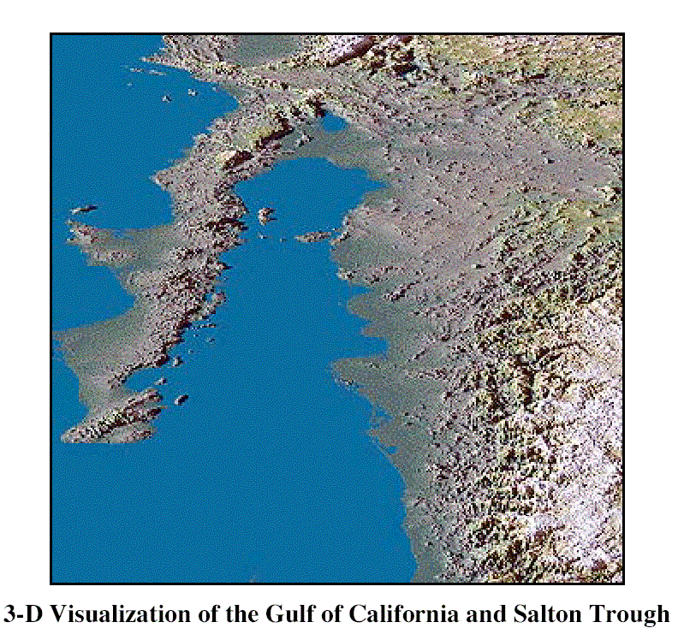
Salton Trough
Gulf of California
Notes:
The Salton Trough is geologically the northernmost extension of the Gulf of California – a giant rift which has torn Baja California away from mainland Mexico and which will eventually rift Southern California from Southern Arizona.

Slide 3
Colorado River Delta
Notes:
The delta of the Colorado River currently separates the two, but because the delta grew westward with time, that was not the case prior to about 5 million years ago when sea water from the Gulf of California extend all the way into the Salton Trough.

Slide 4
Peninsular Ranges
Notes:
The geologic history of the Salton Trough is closely related to that of the Peninsular Ranges…

Slide 5
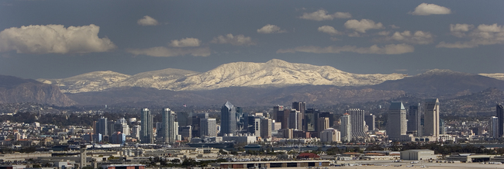
Cuyamaca Mountains
San Diego
Notes:
… otherwise known as the Cuyamaca Mountains in San Diego County. Although the geologic history of southern California is long and complex, it can be simplified into four episodes easily remembered by the mnemonic …

Slide 6
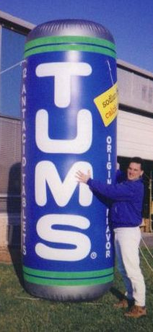
 | EVENTS | ERA
T | Termination of subduction, Thermal expansion, Tilting, Translation, Transtension, Transpression, Terracing | LATE CENOZOIC
U | Under-plating Uplift Un-roofing Undulating | EARLY CENOZOIC
M | Magmatic Madness Metamorphism | MESOZOIC
S | Stable Shelf Sedimentation | PALEOZOIC
Notes:
… “TUMS”. Or if you prefer to work forward in time, that becomes the decidedly spicier mnemonic …

Slide 7
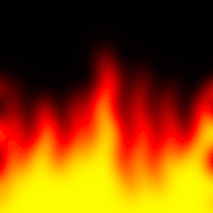
 | EVENTS | ERA
 | Translation Transtension, Transpression Terracing | LATE CENOZOIC
 | Under-plating Uplift Un-roofing Undulating | EARLY CENOZOIC
 | Magmatic Madness Metamorphism | MESOZOIC
 | Stable Shelf Sedimentation | PALEOZOIC
T
U
M
S
Notes:
… SMUT!

Slide 8
 | EVENTS | ERA
 | Termination of subduction, Thermal expansion, Tilting, Translation, Transtension, Transpression, Terracing | LATE CENOZOIC
 | Under-plating Uplift Un-roofing Undulating | EARLY CENOZOIC
 | Magmatic Madness Metamorphism | MESOZOIC
 | Stable Shelf Sedimentation | PALEOZOIC
T
U
M
S
Notes:
In either case the oldest era, the Paleozoic, is represented by the “S” which stands for Stable Shelf Sedimentation.

Slide 9
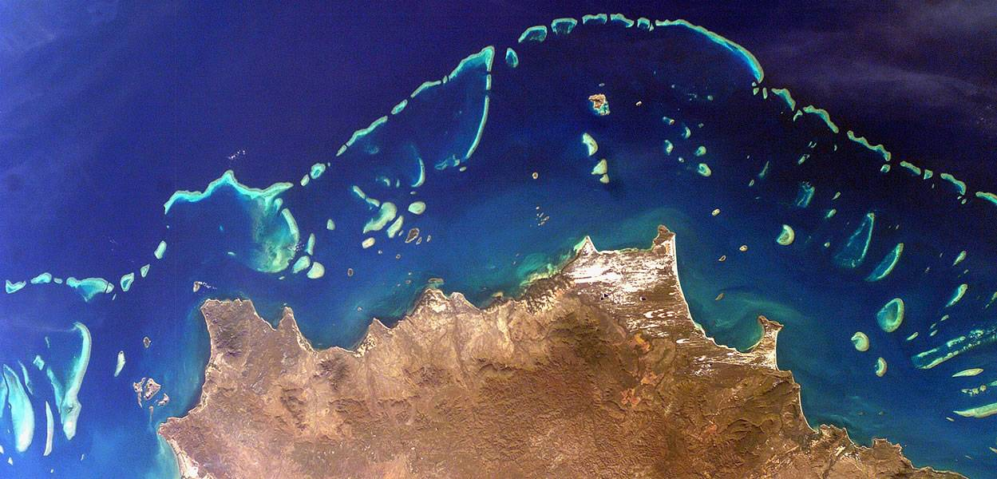
Limestone
Very little sediment
no mountains
Great Barrier Reef, Australia
Notes:
The Great Barrier Reef in Australia is an excellent modern day analogue for the stable shelf sedimentation that characterized the western United States during the Paleozoic Era. “Stable” refers to the fact that mountain building has not happened in quite a long time, so the land has been eroded nearly to sea level and therefore very little sediment is shed from the land into the ocean. The lack of land-derived sediment combined with the warm water create the ideal conditions are for coral growth and the deposition of limestone.

Slide 10
ARIZONA
SAN DIEGO
Stable Continental
Crust (craton)
Limestone
Ocean Crust
Largely destroyed by subduction!
Discontinuously preserved
Notes:
During the Paleozoic, most of present day San Diego County would have been located a few hundred kilometers seaward from the edge of the continental shelf where the bulk of sedimentation took place. Much of that stable shelf sedimentation was limestone. Although deep water sediments would have been deposited in Paleozoic San Diego, they are not preserved anywhere today because they would have all been destroyed by subduction in the Mesozoic. Nonetheless, in the extreme eastern parts of San Diego County and in Imperial County the Paleozoic continental shelf sediments are preserved because continental crust does not subduct.

Slide 11
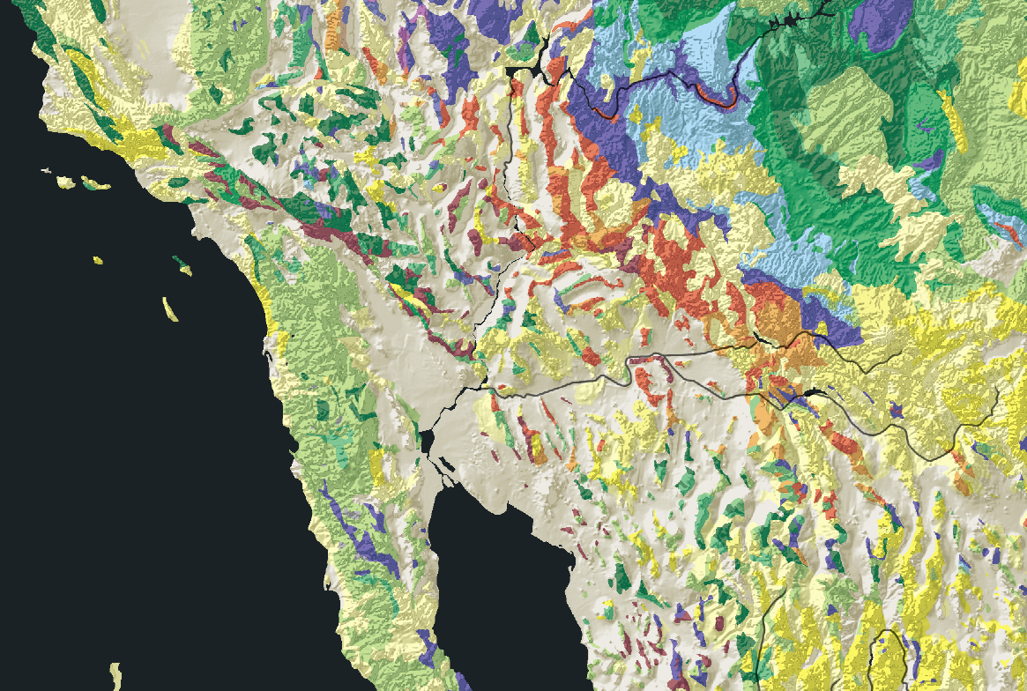
Paleozoic rocks
Notes:
Exposed Paleozoic rocks, shown in purples and blues on this geologic map, are rare and discontinuous in San Diego County because younger events have disrupted, eroded or buried them.

Slide 12
Grand Canyon
Notes:
The most extensive exposures of Paleozoic rock in western North America occur around the Grand Canyon region which was not severely affected by later mountain building events.

Slide 13
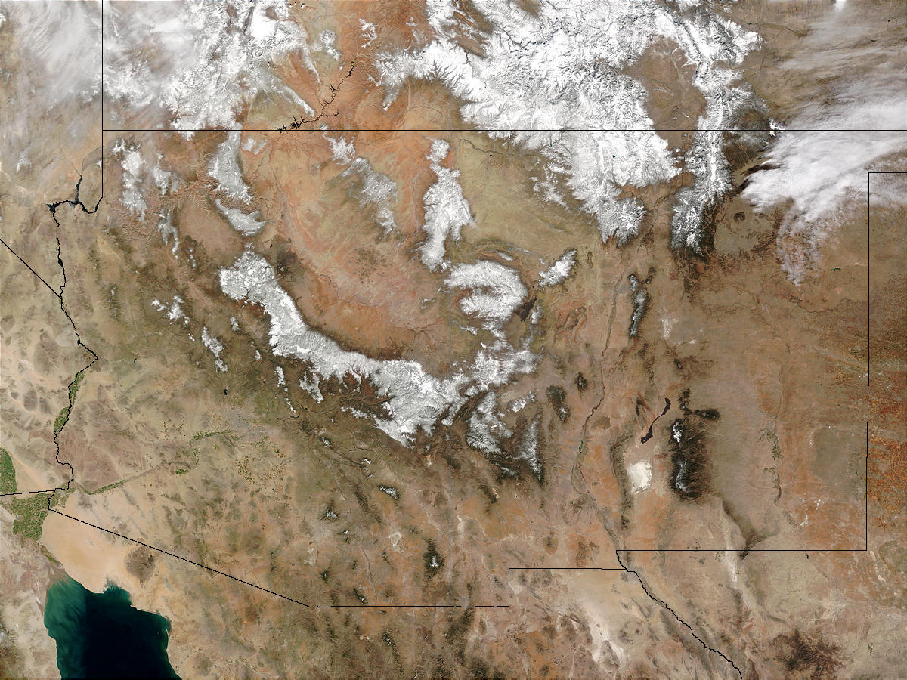
Paleozoic Limestone
Colorado River Delta
Notes:
Since limestone is relatively soluble, the Colorado River transports a good deal of that Paleozoic limestone around the Grand Canyon region to its delta south of the Salton Trough as dissolved ions.

Slide 14
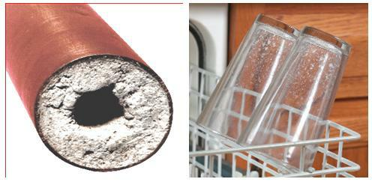
Notes:
We see the dissolved Paleozoic limestone precipitate today as lime scale and water spots because we get much of our water supply from the Colorado River.

Slide 15
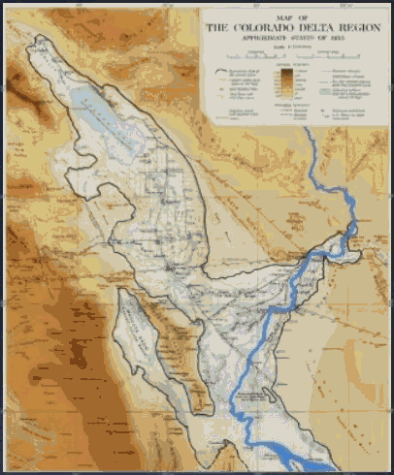
Notes:
We also see massive quantities of that dissolved lime deposited in the Salton Trough because as the Colorado River shifted its course across its delta, it would periodically drain into the Salton Trough and create large, temporary lakes…

Slide 16
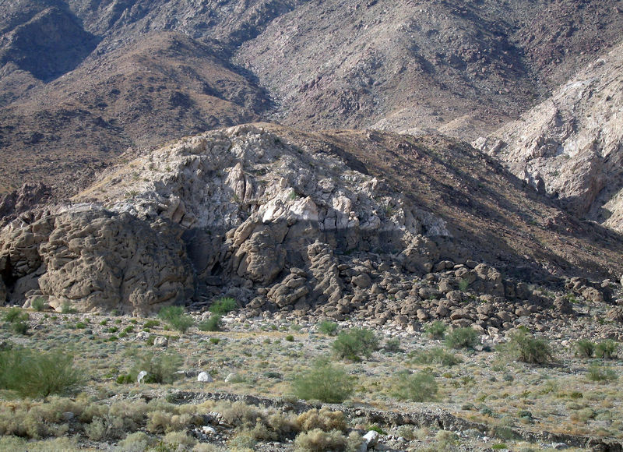
Algae removes CO2 - acidity decreases
- lime precipitates
Ancient Lake Cahuilla
Notes:
… around the shores of which lime deposited because algae growing near the surface reduced the acidity of the lake by removing CO2 via photosynthesis.

Slide 17
Travertine Point (sort of)
Paleozoic Lime (Marble)
Holocene Lime (Travertine)
Notes:
Such lime deposits are called travertine, and form a bathtub-like ring around portions of the Salton Trough - marking the shoreline of the ancient lake. These deposits are especially well preserved at Travertine Point where they form a several-inch thick crust on some of the only exposures of Paleozoic lime in the county. At this intriguing local one can ponder the processes that led to the remarkable pairing of both the oldest and youngest rocks in the county and take comfort in the fact that nature has reunited these distantly related rocks.

Slide 18
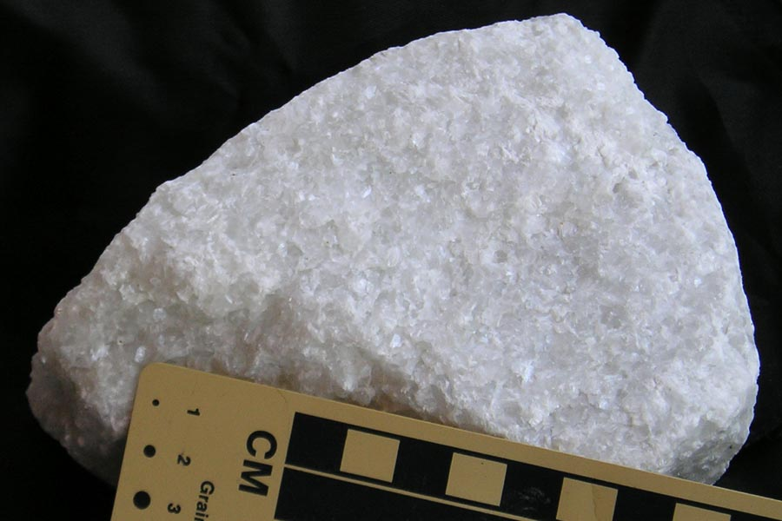
Marble (metamorphosed limestone)
Notes:
Like most of the Paleozoic rock in southern California, the Paleozoic limestone at Travertine Point was changed into a metamorphic rock by major mountain building events during the Mesozoic. Here the old limestone metamorphosed into the coarsely crystalline rock “marble” and is our segue into Chapter “M” in the book of SMUT.

Slide 19
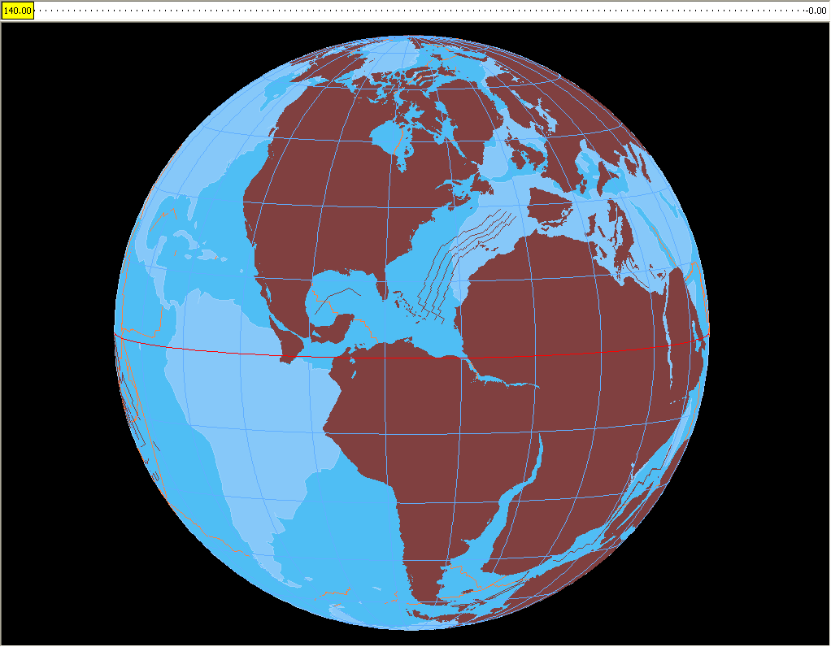
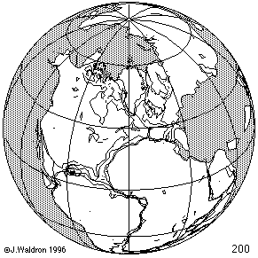
Pangaea Breakup
Pangaea’s Breakup ends Paleozoic Stability
Notes:
19
Most of the geologic events which characterize the Mesozoic era in southern California are related to the breakup of Pangaea which caused North America to move westward across the lithospheric plates that comprised the Pacific sea floor at the time.

Slide 20
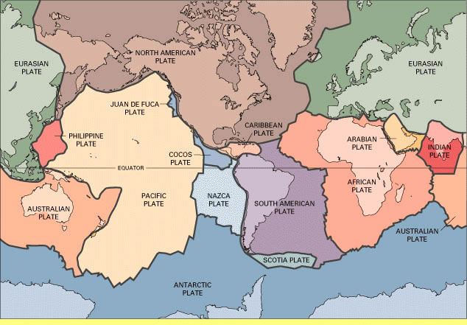
Lithospheric Plates
Notes:
Plates are large pieces of the earth’s fractured outer shell, or lithosphere. Lithospheric plates are made of two brittle layers, the crust and uppermost mantle and move relative to each other …

Slide 21
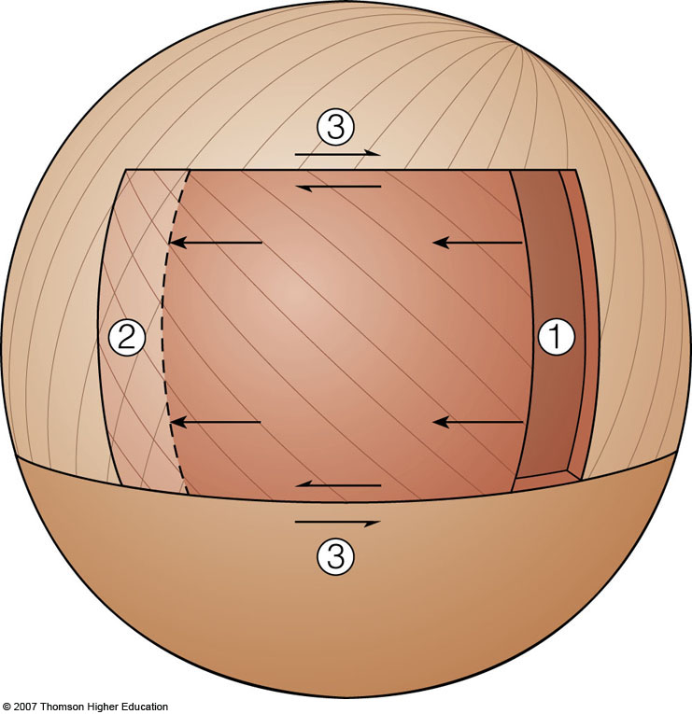
Plate B
Plate A
Plate C
Fig. 3-16b, p. 75
Notes:
... to create three basic types of plate boundaries.

Slide 22
Plate B
Plate A
Gap: divergent plate boundary
Plate C
Fig. 3-16b, p. 75
Notes:
Divergent plate boundaries occur when plates move apart. In general, divergent plate boundaries create ocean basins filled by sea water and newly created oceanic lithosphere.

Slide 23
Plate B
Overlap: convergent plate boundary
Plate A
Plate C
Fig. 3-16b, p. 75
Notes:
Convergent plate boundaries happen where plates collide. Generally one plate is thrust over and the other subducts into the mantle where it generates magma that later rises to the surface to form continental crust.

Slide 24
Sliding: transform plate boundary
Plate B
Plate A
Plate C
Fig. 3-16b, p. 75
Notes:
Transform plate boundaries occur where plates slide past one another laterally without producing any gap or overlap.

Slide 25
 | EVENTS | ERA
 | Termination of subduction, Thermal expansion, Tilting, Translation, Transtension, Transpression, Terracing | LATE CENOZOIC
 | Under-plating Uplift Un-roofing Undulating | EARLY CENOZOIC
 | Magmatic Madness Metamorphism | MESOZOIC
 | Stable Shelf Sedimentation | PALEOZOIC
T
U
M
S
Notes:
The “M” in our mnemonic not only reminds us of the Mesozoic Era (~250-65mya), but also the massive quantities of magma generated by subduction and the metamorphism associated with the emplacement of that magma into the crust.

Slide 26
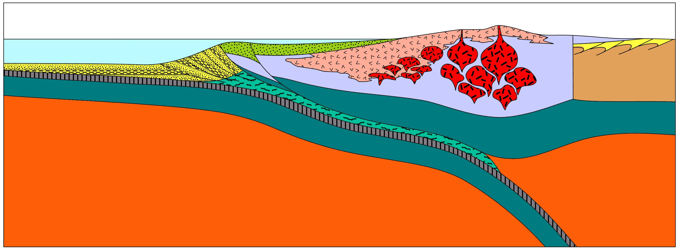
 | Magmatic Madness Metamorphism | MESOZOIC
M
Volcanic Arc
Plutons
Stable
Craton
Farallon Plate
North American Plate
Notes:
Mesozoic activity centered on the subduction of the Farallon Plate beneath oceanic lithosphere attached to the western margin of the North American Plate. Continuous subduction of the Farallon Plate throughout the era formed both volcanic and plutonic igneous rocks along a Japan-like volcanic island arc that grew and ultimately connected to the mainland. Erosion has removed most of the volcanic rock and exposed 100’s of individual plutonic rock masses, or plutons, throughout the Peninsular Range.

Slide 27
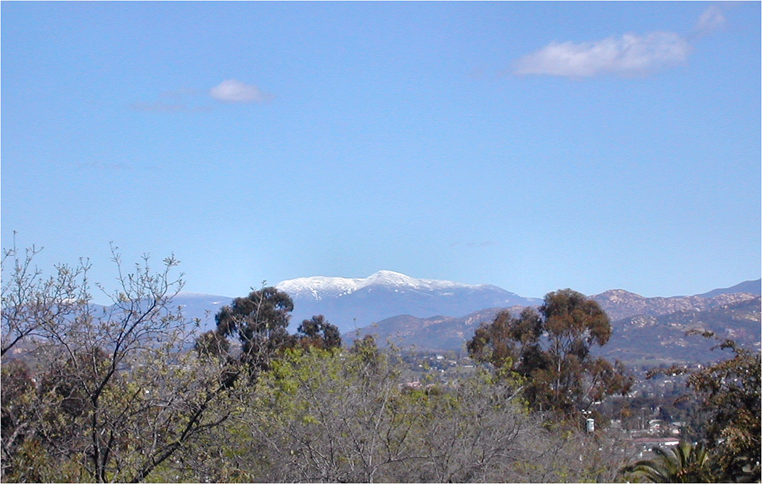
Backbone of Cuyamaca Mountains = Complex of 100’s of Plutons
Notes:
So the Cuyamacas Mountains and the rest of the Peninsular Ranges are an exposed complex of hundreds of plutons.

Slide 28
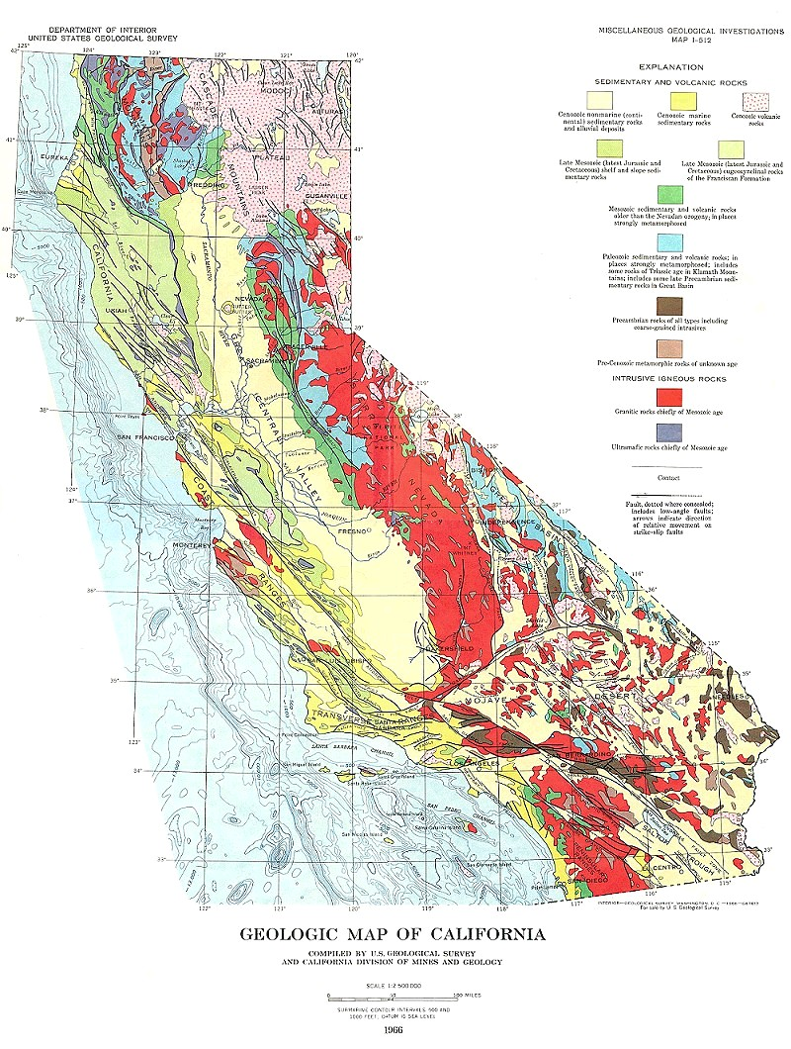
Batholiths
Notes:
Collectively such pluton complexes are called batholiths. Shown in red on this geologic map, the Sierra Nevada batholith dominates the geology of central California, while in southern California …

Slide 29
Notes:
… the Cuyamaca Mountains represent the northern-most portion of the Peninsular Ranges batholith, which extends down the length of the Baja California peninsula.

Slide 30
 | Magmatic Madness Metamorphism | MESOZOIC
M
Accretionary Wedge
Forearc Basin (Point Loma / Cabrillo Fm.)
Regional Metamorphism
(Santiago Peak Volcanics, Julian Schist, Marble)
Forearc thrusting and subduction erosion
Peninsular Ranges Batholith
Metamorphosed wedge sediments (Catalina - Orocopia schists)
Notes:
While subduction of the Farallon Plate generated massive quantities of magma that ultimately formed the Peninsular Ranges batholith, associated metamorphism and sedimentation occurred in adjacent areas. To the west, a pile of scraped-off sediments, called an accretionary wedge, accumulated near the trench and were metamorphosed as subduction of the Farallon plate shoved those sediments deep beneath the leading edge of the North American Plate. Remnants of the attached oceanic lithosphere were largely removed by thrust faulting and subduction erosion. Between the accretionary wedge and the volcanoes, a low area called a forearc basin formed. Forearc basins fill with sediments derived almost entirely from the erosion of the volcanic arc and underlying batholith. In San Diego, Mesozoic forearc basin sedimentary rocks are represented by the Point Loma formation and the Cabrillo Formation. Around the hot batholith a broad region of metamorphism affected pre-batholithic volcanic and sedimentary rocks -now represented by rocks like the Santiago Peak Volcanics, Julian Schist and much of the marble we see in the Salton Trough.

Slide 31
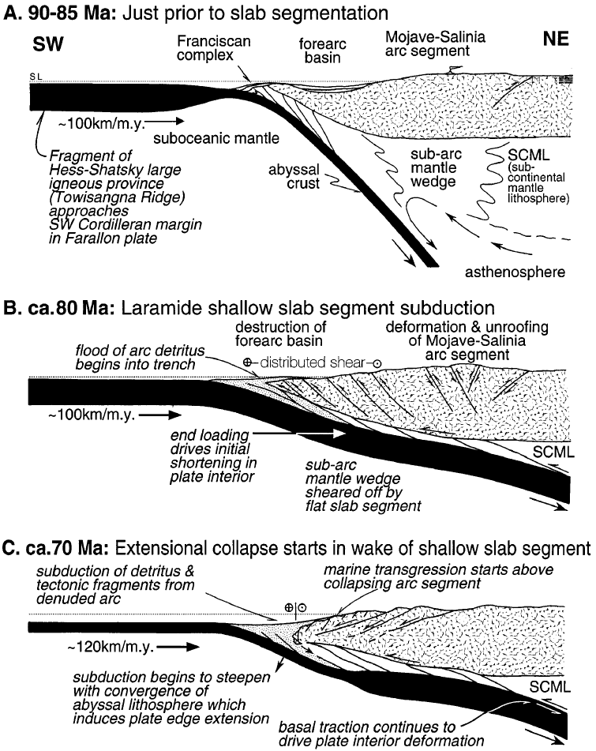
Subduction Flattens
Pleistocene to Recent (0–1.6 Ma)
Paleocene (58–66 Ma)
Pliocene (1.6–5 Ma)
Late Cretaceous (66–88 Ma)
Miocene (5–24 Ma)
Middle Cretaceous (88–118 Ma)
Oligocene (24–37 Ma)
Early Cretaceous (118–144 Ma)
Eocene (37–58 Ma)
Late Jurassic (144–161 Ma)
Notes:
31
Although subduction of the Farallon Plate continued until about midway through the Cenozoic era, early Cenozoic subduction was markedly different than that of the Mesozoic. During the Early Cenozoic the arrival of significantly thicker oceanic lithosphere at the trench greatly flattened the subduction angle of the Farallon Plate …

Slide 32
 | EVENTS | ERA
 | Termination of subduction, Thermal expansion, Tilting, Translation, Transtension, Transpression, Terracing | LATE CENOZOIC
 | Under-plating Uplift Un-roofing Undulating | EARLY CENOZOIC
 | Magmatic Madness Metamorphism | MESOZOIC
 | Stable Shelf Sedimentation | PALEOZOIC
T
U
M
S
Notes:
… and led to several events which can be remembered by the “U” in SMUT.

Slide 33
 | Under-plating; Unusually thick Farallon Plate; Uplift; Un-roofing; Undulating peneplain | EARLY CENOZOIC
U
Un-roofed batholith
Undulating peneplain
Uplift
Orocopia Schist
Underplating
Unusually thick Farallon Plate
Magma production shifts east
Notes:
Underplating here refers to the low-angle thrusting of the Farallon Plate beneath the N. American Plate, which shifted magma formation from the Peninsular Ranges to as far inland as New Mexico and Western Texas. Meanwhile the plutons of the Peninsular batholith fully cooled and hardened, and the leading edge of the North American Plate ramped up and over the flattened Farallon Plate. The associated uplift and erosion un-roofed the Peninsular Ranges batholith leaving a low, somewhat undulating peneplain which sloped gently all the way from what today is Sonora, Mexico towards the Pacific coast.

Slide 34
Erosion is usually compensated by uplift from isostatic rebound
Mantle flow
Notes:
Eroding a mountain range down to a broad, near-sea level peneplain takes a long time (~30 million years) partly because erosion is compensated to some degree by uplift from isostatic rebound. An iceberg illustrates this principle. If the top of the iceberg melts the force of gravity is reduced on the base of the iceberg and its buoyancy will cause it to rise – replacing much of what once stood above water. Similar adjustments take place when a mountain is eroded, but mantle (rather than water) must flow in to replace the uplifted mountain root.

Slide 35
 | Un-compensated erosion | EARLY CENOZOIC
U
Un-roofed batholith
Undulating peneplain
Orocopia Schist
Underplating
impairs mantle flow to mountain’s root
Unusually thick (and cold) Farallon Plate promotes crustal rigidity
Notes:
But little isostatic rebound occurred in the Peninsular Ranges because underplating of the unusually thick Farallon Plate prevented the flow of mantle to these mountains’ roots. In effect, the Peninsular Ranges were “stuck” to the Farallon Plate. Isostatic rebound was further inhibited because the relative coolness of the Farallon Plate allowed the plutons of the Peninsular Ranges batholith to fully harden and the leading edge of the North American plate to become so rigid that isostatic rebound could not be accomplished by continental flexure. Thus isostatic rebound was suppressed and the Peninsular Ranges could erode to a broad undulating peneplain in a scant 10 million years or so. It is important to emphasize here that although isostatic uplift did not occur, it was nonetheless “locked and loaded” into the peneplain – ready for a trigger to release it.

Slide 36
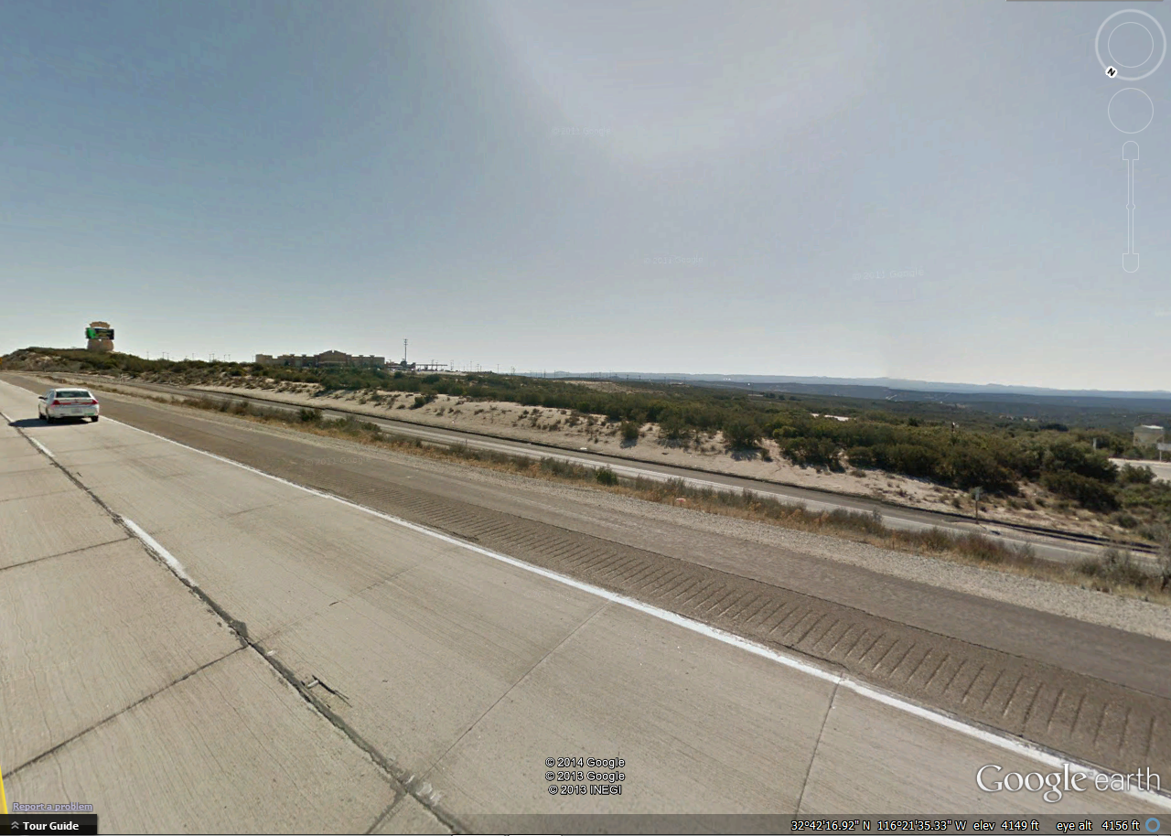
UPLIFTED PENEPLAIN
Notes:
That trigger will be pulled in the Late Cenozoic when uplift of the Early Cenozoic peneplain will create the broad flat surface seen in many portions of the Cuyamaca Mountains.

Slide 37
 | Under-plating Uplift Un-roofing Undulating | EARLY CENOZOIC
U
Un-roofed batholith
Forearc Basin
(La Jolla / Poway groups)
Undulating peneplain
Catalina Schist
Uplift
Orocopia Schist
subduction erosion
Underplating
Unusually thick Farallon Plate
Magma production shifts east
Notes:
Before the peneplain was uplifted, however, it formed a gentle but continuously sloping surface from the Pacific all the way to Sonora Mexico. It allowed a vast amount of sediment to be transported west, which deposited mostly in the forearc basin as sedimentary rock units like the Poway and La Jolla groups. The low subduction angle and perhaps unusual thickness of the subducted Farallon Plate resulted in the flattening of the base of the continental lithosphere by subduction erosion. Such flattening not only made the thickness of the overlying lithosphere more uniform (thereby promoting peneplanation), but subduction erosion also created an unrestricted channel by which underthrusted accretionary wedge and forearc basin sediment could be metamorphosed and transported far east of the Peninsular Ranges as the Orocopia Schist. An unusually large amount of sediment may have subducted and metamorphosed in the wake of the proposed unusually thick portion of the Farallon Plate, thus explaining the great volume of Catalina Schist underlying the Southern California continental borderland. Eventually far less sediment subducted, however, because progressively younger portions of the Farallon Plate arrived at the trench as the western margin of the North American Plate pushed ever closer to the divergent plate boundary between the Farallon and Pacific Plates.

Slide 38
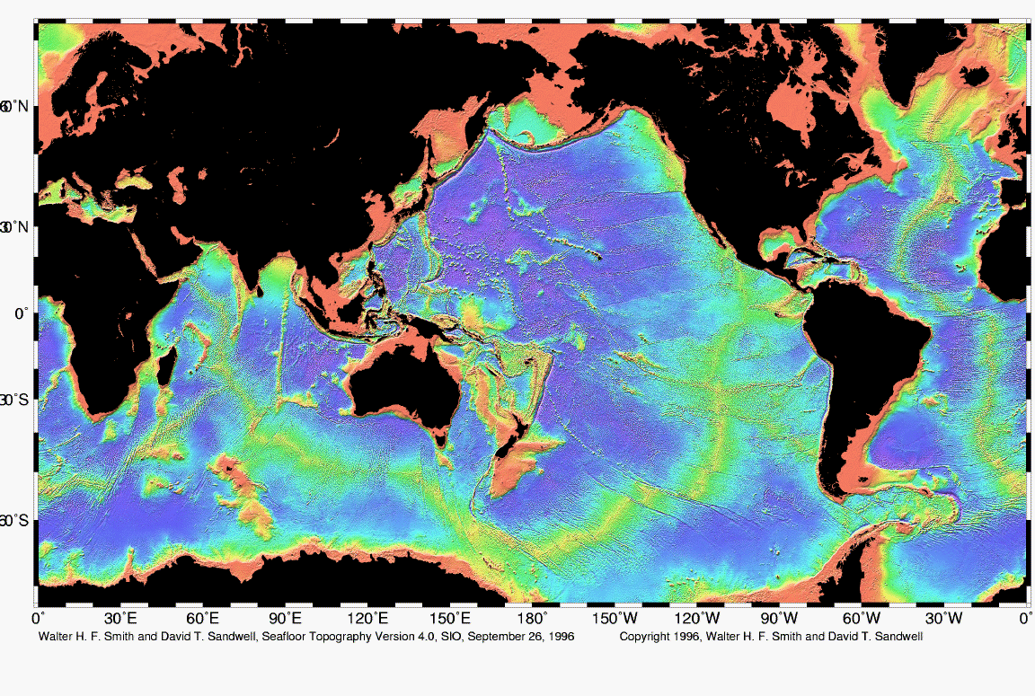
East Pacific Rise
Notes:
That divergent plate boundary still exists today as the East Pacific Rise, but not off shore of southern California because the North American plate was shoved over it in the late Cenozoic era.

